Slide 1
Market Mechanism
of
New Business Model
- Business Development Department

Slide 2
Market Mechanism With the example of GOLD Contract
- Background to the model
Market Makers (MMs) shall be allowed to Quote with the help of the reference price i.e. External Price Link (EPL).
Quantity represents intention of both Buy and Sell Quotes for a particular contract. Unmatched quantities are editable but it results in equal change in quantities of both BID & ASK.
MMs can choose the Spread (+/-) on EPL Price and can show their intentions for BID & ASK Quotes for different contracts; however maximum spread will be fixed by the Exchange. Thus, quotes with the least spread gets the priority and results in best available price. However, spread can be edited unless executed.
MMs | Quantity | Spread | Time
MM1 | 5 | 1 | t1
MM2 | 10 | 4 | t2
MM3 | 8 | 2 | t5
MM4 | 5 | 3 | t7
MM5 | 5 | -1 | t4
MM6 | 2 | 3 | t6
MM7 | 3 | 0 | T3
MM^{n} | Q^{n} | S^{n} | T^{n}
After Price Priority, the time of the intention for BID & ASK Quotes is the second priority while matching orders. For example, in the table above, MM4 and MM6 both have shown intention with the same spread i.e. 3 but MM6 had shown the intention before MM4, hence MM6 gets the priority before MM4. If the spread or even quantities are modified, the modification time will be effective for Time Priority.

Slide 3
Benefits
Competitive Advantage: MM quoting competitive prices are likely to have their orders executed sooner rather than later. They can deal with the huge number of participants (all the clients & MM affiliated with the exchange) under Price-Time Priority principle.
Clients also get competitive quotes because of lowest spread by large number of MMs.
Equal change in quantity in both sides (BID & ASK) ensures balanced Market Depth (Volume) in every situation.
In the scenario of MM intention being matched from one side only, i.e. either BID or ASK, the equal number of intentions will be blocked from the opposite side for the cancelation only till the MM has open position/s from first side; this further ensures balance between two sides of Market Depth.

Slide 4
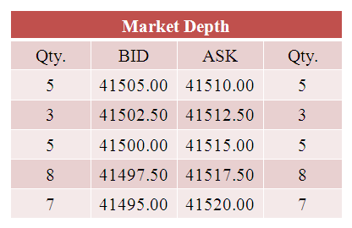
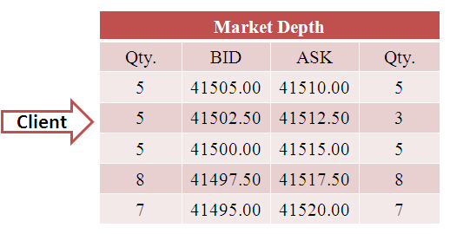
Market Mechanism
-BID/ASK Price Calculation and Visibility of Limit Orders in Market Depth
In the Market Depth, only 5 Best BID and ASK Prices are displayed, however the identification of any MM for any particular quote will not be disclosed.
If MM1 chooses 1 Spread, 1 tick will be added on EPL ASK Price and 1 tick will be deducted from EPL BID Price and the resulting price gives BID and ASK Price for MM1.
Other BID and ASK Prices for other MMs are also calculated in the same way.
Clients’ Limit orders will also be visible in the Market Depth, if the Limit prices fall within the best 5 BID and ASK quotes.
Clients’ Buy Limit order will be visible in BID side and Sell Limit in ASK side. (e.g. Client takes 2 Buy Limit order at Rs. 41502.50 and the quoted Buy Limit Price falls in best 5 BID and ASK .
Note: Contingency Pip will be considered
as and when the Clients/MMs place the Limit Orders.
MMs | Quantity | Spread | Time
MM1 | 5 | 1 | t1
MM2 | 10 | 4 | t2
MM3 | 8 | 2 | t5
MM4 | 5 | 3 | t7
MM5 | 5 | -1 | t4
MM6 | 2 | 3 | t6
MM7 | 3 | 0 | t3
MM^{n} | Q^{n} | S^{n} | t^{n}

Slide 5
Benefits
Visibility of clients’ Limit Order in Market Depth will ensure higher level of transparency.
Clients’ Limit Order in Market Depth increases volume of Market Depth which results in higher liquidity.
Clients’ Limit Orders will also compete with MMs’ EPL quotes which makes quotes more competitive and narrows the spread.

Slide 6
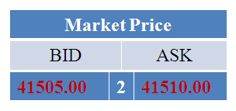
Market Mechanism
-Structure of Market Depth
In the Market depth, quotes of the Market Makers and clients will be sorted in the following way:
ASK Price will be sorted in ascending order i.e. lower to higher
BID Price will be sorted in descending order i.e. higher to lower
Highest BID is the best BID and lowest ASK is the best ASK, which represents the best available price (Market Price) too.
Market Maker quoting minimum spread will get the priority of order execution.
However, clients Buy Limit (highest) and Sell Limit (lowest) will also get the priority of order execution.
If two or more than two market participants (MM or client) have the same quotes, then the time of orders placed will be given the priority thereafter.
1st Priority
2nd Priority
4th Priority
5th & 6 ^{th} Priority
3rd Priority
7th Priority
MMs | Quantity | Spread | Time
MM1 | 5 | 1 | t1
MM2 | 10 | 4 | t2
MM3 | 8 | 2 | t5
MM4 | 5 | 3 | t7
MM5 | 5 | -1 | t4
MM6 | 2 | 3 | t6
MM7 | 3 | 0 | t3

Slide 7
Benefits
Risk Management: MM can use wider spread to safeguard their positions in unfavorable market conditions.
Non-Disclosure of MMs: In the market depth, the identification of any MM for any particular quote is not disclosed which ensures confidentiality and anonymous Quoting .

Slide 8
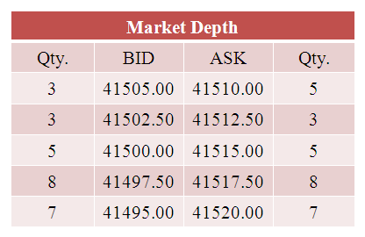
Market Mechanism
- Change in Market Depth when Clients place orders
If any client takes Market Order or their contingent Order gets triggered, then order of the client will be matched to the best available quotes of the MMs or clients limit orders. Consequently BID or ASK quantities will be adjusted accordingly in the Market Depth.
For example if any client takes 2 lots of Sell order then the quantity of Best BID will be reduced by 2 quantity.
The validity of the MM’s open positions will depend on the Matched Order of the Client. (E.g. If a client takes Intraday Buy order then MM, whom the order matches with, will get the Intraday Sell open position.)
Before
After
Buy | Sell
Qty. | 2
Buy | Sell
Qty. | 2

Slide 9
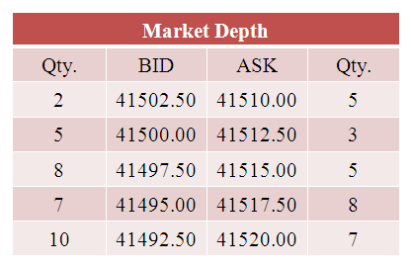
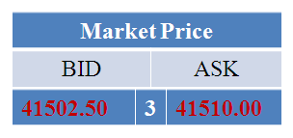
Market Mechanism
- Contd..
Before
If again, another client takes 4 lots of Sell Order then the quantity of best BID will be deducted collectively from first and second best BID prices i.e. 3 from first and remaining 1 lot will be reduced from next best BID Price. Remaining best BID Price of 2 lots will be best BID Price thereafter. (unless more competitive quotes are placed)
Incase of contingent orders, the orders will be executed for matched quantity/price only, any remaining quantity of contingent orders will stay pending till Market Price attains the set contingent price.
After
Buy | Sell
Qty. | 4
Buy | Sell
Qty. | 4

Slide 10
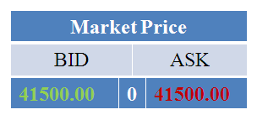
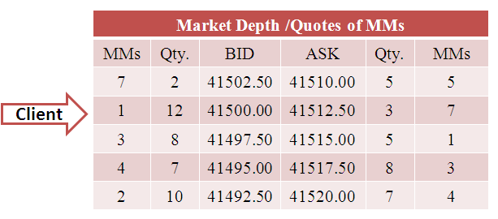
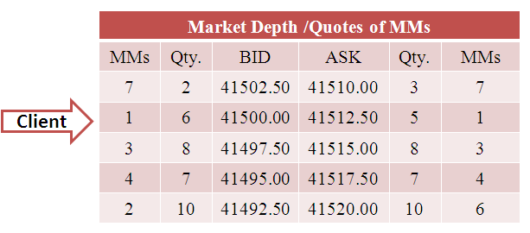
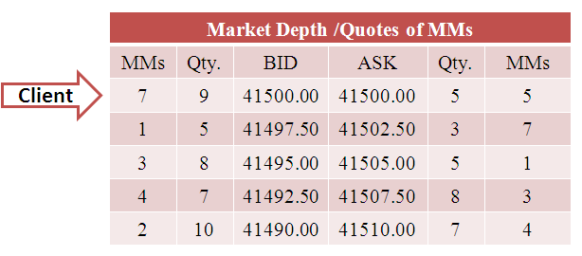
Market Mechanism
- Contd..
If Client’s Buy Limit order is in the Market Depth then her/his order will be executed either if Buy Limit price matches with ASK Price or another Client/MM takes sell position while Buy Limit order in the Best Priority (Price and Time both) and the same will be applicable for Sell Limit order too.
Here, in the example Client’s Buy Limit order is in Market Depth and the quoted price is 41500.00 with 7 quantity.
If Buy Limit Price matches with the ASK Price then the matched quantity i.e. 5 will be deducted from both BID and ASK side and the remaining 2 Buy Limit order will be pending for the client.
If again another Client/MM takes 1 sell order at the time of Best Priority of Buy Limit then one quantity will be reduced from BID side only and remaining 1 will be pending thereafter.
Buy | Sell
Qty. | 1
Buy | Sell
Qty. | 1

Slide 11
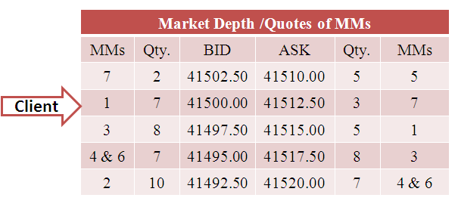
Market Mechanism
- Order Matching
A Client takes a Buy position on ASK Price and Sell on BID Price.
When a client takes a Buy Market Order or his/her contingent order is triggered, then:
The client gets open Buy position and s/he can settle his/her position on market BID Price, P/L will also be calculated accordingly.
At the same time, the respective MM/client also gets open Sell position and it can also close its position on market ASK price, based on order matching. So the same MM may not get the Buy and Sell of the same client.
There will be a difference in the total profit & loss, displayed in the below table as Net Market P/L, which is the unrealized spread and it will be equal to the prevailing spread.
Unrealized Spread will be adjusted for MTM Calculations.
Sell | Buy
Qty. | 1
Sell | Buy
Qty | 1

Slide 12
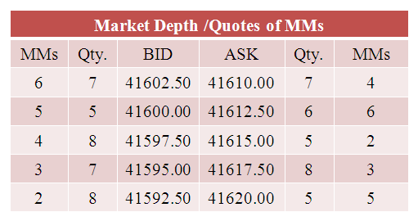
Market Mechanism
- Risk Mitigation
MM can mitigate the risk by closing the unfavorable positions any time during trading hours.
Sell Open position of the MM will be closed on Market Ask Price and Buy Open Position will be closed on Market Bid Price, as similar to client.
In such conditions, further Risk and Benefit will be transferred to the next best MM /client with the best BID and ASK Prices.
There won't be any impact on client’s open position (excluding Unrealized Spread)
Sell | Buy
Qty. | 0
Note: If any MM wants to transfer it’s further risk and benefit back to the market, in such condition MM needs to make sure it’s intention should not be in best for relevant BID/ASK side. If its intention is best in relevant side then MM can re-quote worst spread to give the priority to other MMs/clients for best BID/ASK then only can transfer to other MMs/clients, and after that can again re-quote the best spread for the priority of execution.

Slide 13
Market Mechanism
-Risk Mitigation
In the same way clients also can close their position if they are unwilling to take further risk or benefit.
If a client places an order to settle its existing Open orders, the orders matches with best available fill, whereas the counter position at MM or clients, whom the client initiated open order with, shall remain till an opposite position matches against its MM intention.
The Equity Hit level is 15 % of Used Margin for Market Makers
Sell | Buy
Qty. | 1
Sell | Buy
Qty. | 1

Slide 14
Benefits
Risk Transfer: As there will be many market makers in the trade; one MM can even transfer his open positions back to the market by closing its open positions for risk mitigation. If no orders are matched within the MMs/CMs/clients circle, the orders will be cleared at the Clearing House.
Order matching is possible among Client to Client, Client to MM & MM to MM which gives higher liquidity in the market.

Slide 15
Market Mechanism
-P/L calculation on Mark to Market (MTM)
The Net Market Profit and Loss will be zero for Mark to Market Calculation and at the time of Final Settlement, because there will be single Daily Settlement Price (MTM Price)/Final Settlement Price.
Bank accounts of all CMs & MMs will be adjusted by adding/deducting daily profit and loss calculated based on daily settlement price.
MM/Clients | Position | Qty. | Selling /Buying Price | Daily Settlement Price | Profit/Loss | Net Market P/L
Client | Buy/Sell | 1 | 41510.00 | 41607.50 | 9750 | 0
MM5 | Sell/Buy | 1 | 41510.00 | 41610.00 | 10000
MM4 | Sell | 1 | 41610.00 | 41607.50 | 250
MM6 | Buy | 1 | 41607.50 | 41607.50 | 0

Slide 16
Benefits
All the floating P/L and financial adjustments are done on Mark to Market (MTM) basis i.e. floating P/L along with settled positions’ P/L will be realized in concerned accounts every trading day. In case of profit, one can use the earned profit even before closing the position also. Margin and Storage cost will also be transferred accordingly.
This practice prevents accumulated dues of any market participants to be forwarded to the next trading day.

Slide 17
Market Mechanism
-Incase of insufficient fund with MM
MM can show any number of intentions in any contract at multiple times regardless of available fund; but when these intentions are matched, intentions with insufficient funds can also be matched which will result in cancellation of the remaining intentions and closing of open positions with insufficient funds. Remaining intentions of concern side will be cancelled to make another MM’s price in priority and to close the positions initiated with insufficient funds.
At the time of cancellation of remaining intentions of MM, intentions from both BID and ASK side will be cancelled for the particular contract except the opposite intentions of his open positions [Excluding Open Positions of Self Trade], but the time priority will be changed to the current time.
Clients’ orders will have no effect in the above process.
The entire process will be done immediately.

Slide 18
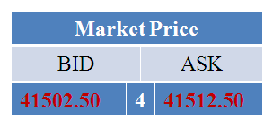
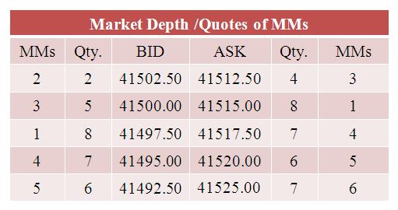
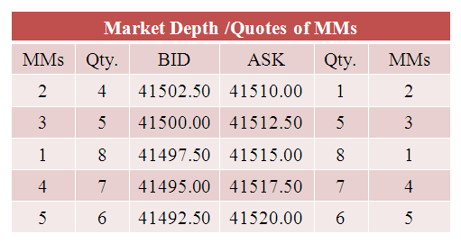
Market Mechanism
-Incase of insufficient fund with MM, Example
In this example, MM2 has sufficient funds only for 2 lots but has shown the intentions of 4 and its price is in priority.
In this case if the client takes 3 Buy Orders then initially all three orders of the Clients will be matched with MM2 and MM2 will have 4 BID and 1 ASK intentions in the first priority.
MM2 doesn't have sufficient funds for one open position so that one open position should be liquidated but to close that position MM2 itself is in priority.
So, the remaining 1 order will be canceled to give the priority to another MM.
Once another MM will get priority, the position with insufficient funds will be liquidated and the further risk and benefits will be transferred to MM3 who is in the first priority thereafter.
At the time of cancellation of remaining intentions of MM, intentions from both BID & ASK sides will be cancelled for the particular contract except the opposite intensions of his open positions [Excluding Open Positions of Self Trade], But the time priority will be changed to the current time.
Sell | Buy
Qty. | 3
Sell | Buy
Qty.
Sell | Buy
Qty. | 3

Slide 19
Market Mechanism
-Liquidation is based on FIFO method
Liquidation is based on FIFO method,
For example, if a MM has two open Buy positions & any client places a Buy order under same MM a/c , which means a Sell position to that MM, then first Buy open position get liquidated and Profit and Loss will be booked accordingly & margin becomes free for the liquidated positions.
Closed Position | Qty. | Selling /Buying Price | Current Price | Floating P/L
Buy | 1 | 41410.00 | 41607.50 | 19750

Slide 20
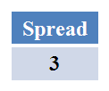
Market Mechanism
-Realization of spread in MM account
If MM6 closes its open sell position throwing back to the market, then the P/L will be realized exactly as floating and the further risk and benefit will be transferred to MM4. Open sell position will be closed on Market Ask Price and similarly open buy position will be closed on Market Bid Price.
Spread will be realized in a MM’s account when a MM gets both Buy and Sell orders from clients/MMs circle.
E.g. MM6 has two open Sell positions and has also got the best BID intention in market depth and if any client takes 2 lot market Sell orders, then open positions of MM6 gets squared off on BID Price because client takes sell orders on the same, which results in the spread realization in MM’s account. i.e. MM’s profit will be increased by the spread value and Loss will be decreased by the same.

Slide 21
Benefits
Spread Benefit: Market Makers are allowed to use given range of spread to quote the prices, which results in good spread benefit for the MMs. The strategic selection of competitive and comparative spread helps to maximize the return and minimize the risk for the MMs.
Margin Release facilities: As MMs are quoting Bid and Ask prices simultaneously; in case of execution of both buy and sell quotes, the initial margin goes free for the particular quantities which allows MMs to increase their trade lots.

Slide 22
Thank You
Mercantile Exchange Nepal Limited
House No. 25, Shesh Marga, Charkhal, Dillibazar, Kathmandu,Nepal. Website: www.mexnepal.com E-Mail: bd@mexnepal.com
Phone: +977-1-4423566/77/88 Fax: +977-1-4417854/55
------------------------------------------------------------------------------------------------
Disclaimer : The features are subject to change in order to best meet the needs of the market.

